Slide 1
Garbage Detection Using CNN
Exploratory Project Report
Anika Singh (21065015)
Dnyanada Deshpande (21065045)
Supervisor: Dr. Shishir Gaur

Slide 2
Abstract
The proposed garbage detection model consists of a CNN backbone that extracts relevant features from the input image and a U-Net architecture that performs semantic segmentation of the garbage regions.
The model is trained on a dataset of garbage images and achieves high accuracy in detecting and segmenting of garbage.
Experimental results show that the proposed model in some cases outperforms existing actual annotated images and can be used for real-time garbage detection applications, such as waste sorting and recycling.

Slide 3
Contents
Introduction
^{Literature} Methodology
Result
Future Work
Refrences
Review

Slide 4
Introduction
Waste management is a crucial issue that affects our environment, health, and economy. Proper waste segregation and disposal are essential for reducing pollution and promoting sustainability. However, manual garbage detection can be time-consuming, labour-intensive, and error-prone, making it a challenging task for municipalities and waste management companies. In recent years, there has been an increasing interest in developing computer vision-based solutions for automated garbage detection.
In this project, we propose a garbage detection model using Convolutional Neural Networks (CNNs). CNNs are deep learning models that have shown remarkable success in various computer vision tasks, including object detection, segmentation, and classification. The proposed model aims to detect and segment different types of garbage from images captured by a camera.

Slide 5
Literature Review
Basis
The basis of this project is semantic segmentation so I began with learning cnn, semantic segmentation and U net Architecture (as I had prior knowledge of basic ml and its algorithms)
Semantic Segmentation
Semantic segmentation is a computer vision technique that involves assigning a semantic label to each pixel in an image. In other words, it involves dividing an image into meaningful segments or regions based on their semantic meaning. For example, in an image of a street scene, semantic segmentation can be used to label each pixel as a pedestrian, car, building, sky, or road. Semantic segmentation is a crucial task in many computer vision applications, including object detection, image segmentation, and scene understanding.

Slide 6
CNN
Convolutional Neural Networks (CNNs) have shown remarkable success in semantic segmentation tasks. CNNs are deep learning models that can automatically learn and extract relevant features from images.
In the context of semantic segmentation, CNNs can be trained to assign a semantic label to each pixel in an image by learning the spatial relationships between pixels and the corresponding semantic labels.
CNNs achieve this by using a series of convolutional and pooling layers that progressively down sample the input image and extract increasingly complex features. By leveraging the power of CNNs, semantic segmentation can be used to accurately detect and segment waste.

Slide 7
Methodology
Methodology
Data Collection
Image Annotation
Data Pipeline
Model
Architechture
Training
Evaluation

Slide 8
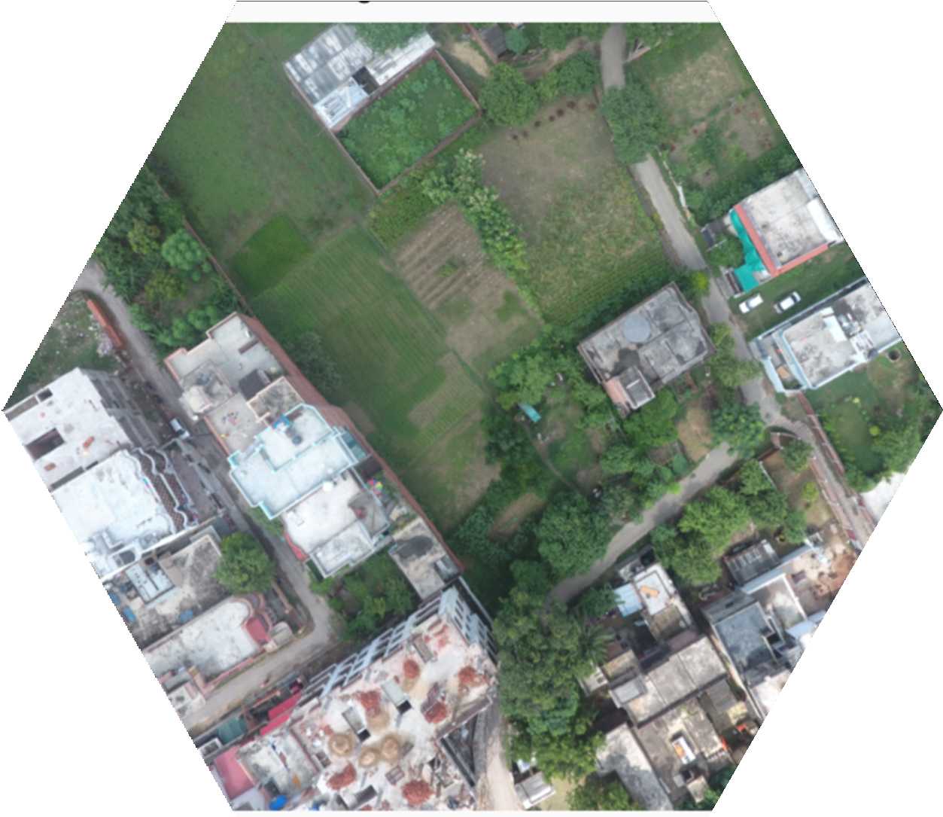
Data Collection
Deep learning techniques are used in the semantic segmentation process, and training the model on a large amount of data is necessary. So, using a drone (UAV), we took over 1000 pictures of Varanasi, India, from various angles to train the model. To train the model to recognize garbage, we carefully chose photographs with clear garbage. There were more than 300 appropriate photographs as a result of the manual selection procedure.

Slide 9
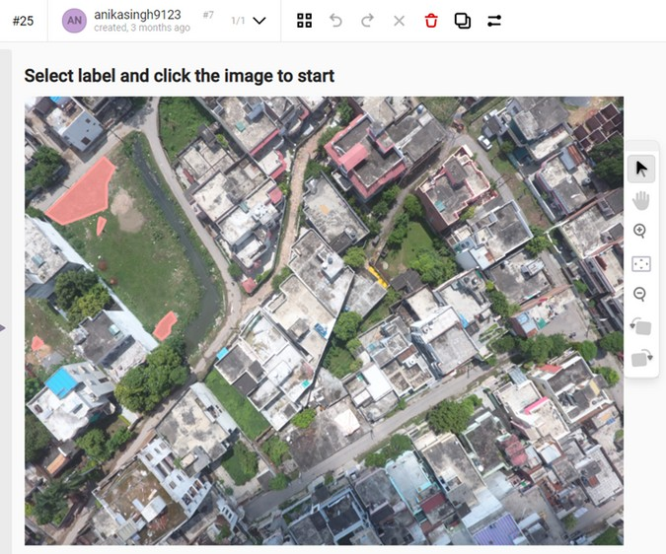
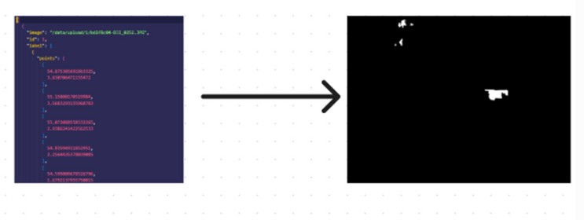
Annotation of images refers to the process of adding relevant metadata or labels to an image dataset to enable machine learning algorithms to learn from the data. In the context of ML models, image annotation involves labeling individual elements in an image such as objects, regions, and shapes with descriptive information. This information is then used as input to train machine learning models to identify and classify different elements in the image.
Image annotation is a crucial step in the development of machine learning models, particularly in computer vision applications, as it helps to ensure the accuracy and effectiveness of the models. For the same need Label studio was installed and used for annotating the images.
Annotating Images
Garbage was manually detected and annotated in all the images and then annotations were converted to JSON Min format.
Next we converted the json files to jpg files to obtain the mask images.

Slide 10
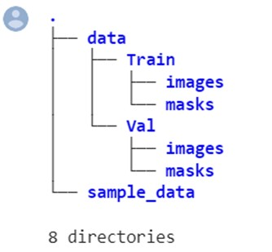
Data Pipeline
It would have been challenging to train the model by creating several pipelines and assuring data flow if the files are saved in JPG format because they are saved in many separate folders. The data (picture and its accompanying mask) must therefore flow from a single directory, and we must create a single path from which it will do so.
So, using this Collab notebook, we renamed the images and masks as necessary and added them to this folder.

Slide 11
Model
Patch-based models are a type of machine learning model that divides an image into smaller sub-images or "patches" and then trains the model on these smaller images. This approach is particularly useful in cases where images are too large to process as a whole or when different regions of the image require different levels of analysis.
In patch-based models, each patch is typically fed through a feature extraction algorithm that extracts relevant features from the image. These features are then used to train the model to recognize specific patterns or features in the image data. The model can then be used to make predictions on new images by dividing them into patches and applying the trained model to each patch.
Patch-based models have been successfully used in various computer vision applications, including object detection, image classification, and segmentation. One of the main advantages of patch-based models is their ability to handle large images, making them particularly useful in medical imaging and satellite imaging applications.

Slide 12
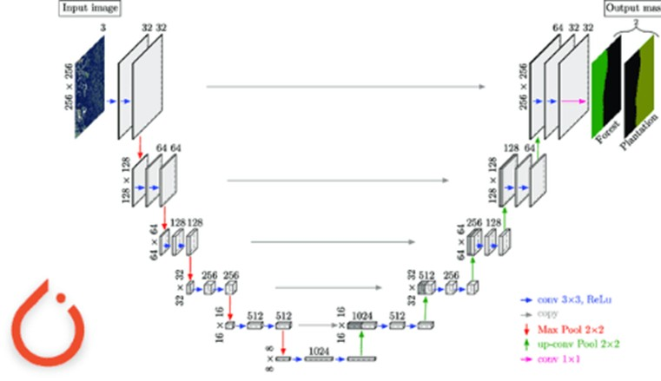
Architecture
The U-Net architecture consists of an encoder and a decoder network. The encoder network is a series of convolutional and pooling layers that extract hierarchical features from the input image. The decoder network is a series of up sampling and convolutional layers that reconstruct the output image from the feature maps generated by the encoder.
The key feature of the U-Net architecture is its skip connections, which connect corresponding layers of the encoder and decoder networks. These skip connections allow the decoder network to leverage both low-level and high-level features from the encoder network, enabling accurate segmentation of objects of different sizes and shapes.
The U-Net architecture also includes several modifications, such as the use of "padding" in convolutional layers to preserve image resolution and the incorporation of batch normalization to speed up training.
The U-Net architecture which we have used in this model uses binary segmentation in which garbage is considered as 1 (foreground) and rest all is considered 0 (background).

Slide 13
Training
https://colab.research.google.com/drive/1gtORsiJg-kQ0jNAVGGCGYyVzWl3w-PLi
In this collab notebook, we loaded the image patches and examined the labels. We discovered that the annotated images had multiple labels, which was not desirable and caused our previous training attempts to fail. To overcome this issue, we transformed the labels into binary labels representing background and foreground (0 and 1, respectively). We then used a data loader to load the data for training the model.
The training process involved using input images and their corresponding segmentation images to train the network with the Adam optimizer. Both inputs and labels were subjected to the same transformation to ensure proper alignment. The model was trained using 50 epochs and a batch size of 16. Binary cross-entropy was used as the loss function, and IOU score was employed as the metric for evaluating the model's performance.

Slide 14
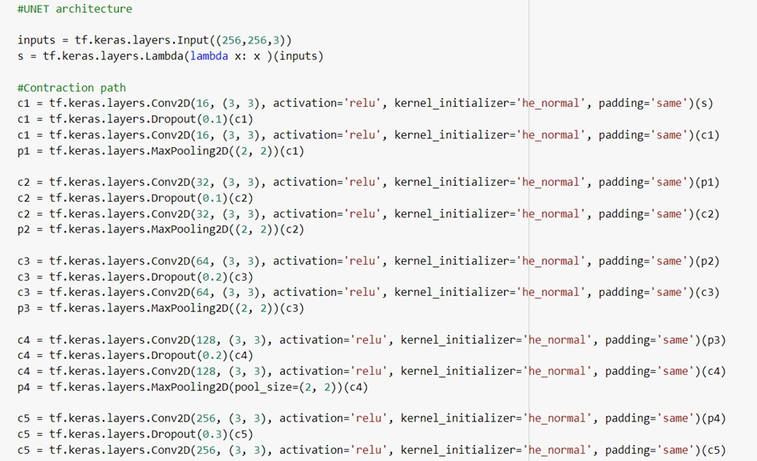
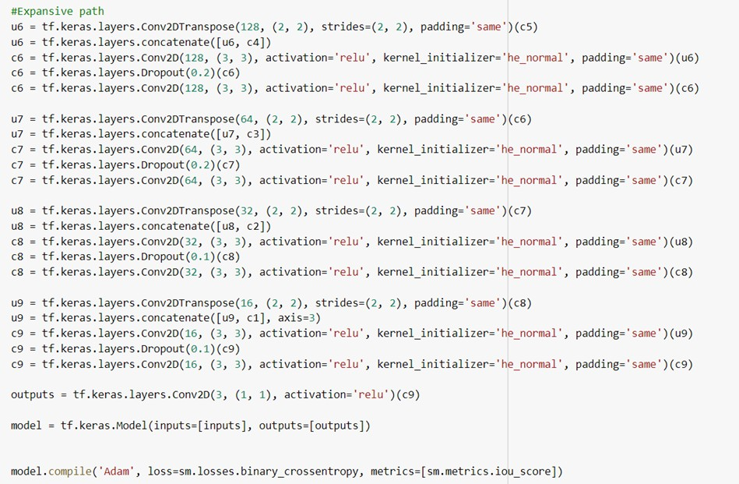
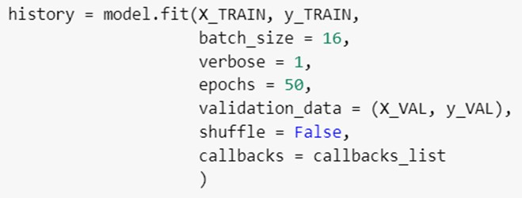

Slide 15
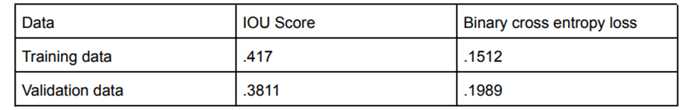
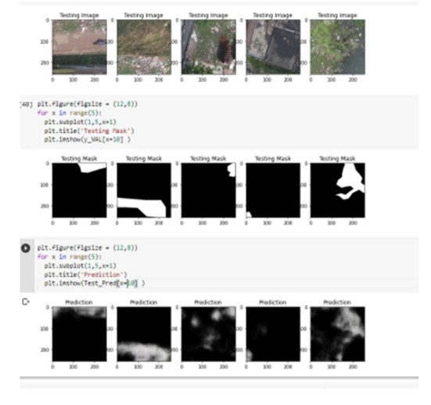
Results
The following result was obtained after training the model
After training the model, IOU score> .5 is considered Ideal, that we got 0.417, so model can further be improved a lot.
Few predictions are as follows

Slide 16
Future Work
The model is performing well and predicting garbage from images; now, our task will be to do the post- processing part and improve the model IOU score to greater than 0.5.
This can be done by:
Model Architecture: Experimenting with different model architectures or variations of existing architectures. This could involve increasing the depth or width of the network, introducing skip connections, or utilizing pre-trained models for transfer learning.
Data Augmentation: Applying data augmentation techniques to increase the diversity of the training data. This can include random rotations, scaling, flipping, or adding noise to the input images and corresponding labels. Augmenting the data can help the model generalize better and improve its performance.
Training Data Quality: Ensuring the quality and accuracy of the training data. Inaccurate or mislabeled annotations can negatively impact the model's performance. Review and validate the training data to minimize any errors or inconsistencies.
Modification:
We can also try to add more functionalities to our model like segregation of waste into plastic ,waste paper waste etc.

Slide 17
Uses Of This Model
Environment:
This model will help detect the garbage hotspots hence helping in effective and targeted cleaniliness.
Health:
As garbage hotspots are breeding ground for various disease causing organisms so locating them would make it easier to eliminate them.
Resource Saving
Accurate identification of garbage filled areas would help in minimum wastage of resources and data based model would help study patterns of garbage deposition over an area or tell area with high waste generation etc.

Slide 18
References
Book:
1."Semantic Segmentation and its Applications" by Jyotsna Kumar Mandal, Nilanjan Dey, and Amira S. Ashour: This book offers a comprehensive exploration of semantic segmentation algorithms and their applications. It covers U-Net as one of the prominent algorithms for semantic segmentation and includes discussions on various aspects of the technique.
Software:
1.Label Studio: A software used for annotating images manually. 2.Google Colab: A software used for preparing and training the model.
Journal:
1. Garbage Classification Using Deep Convolutional Neural Network" by Eka Wahyudi, Tjokorda Agung Budi Prasetia, and Ahmad Basuki. Journal of Telecommunication, Electronic and Computer Engineering (JTEC), 2019.
Conference:
1. International Conference on Computer Vision (ICCV): ICCV is a prominent conference that brings together researchers from the computer vision community. It covers a wide range of topics related to computer vision, including object detection, image segmentation, and visual recognition, which are relevant to garbage detection using CNNs.

